Slide 1
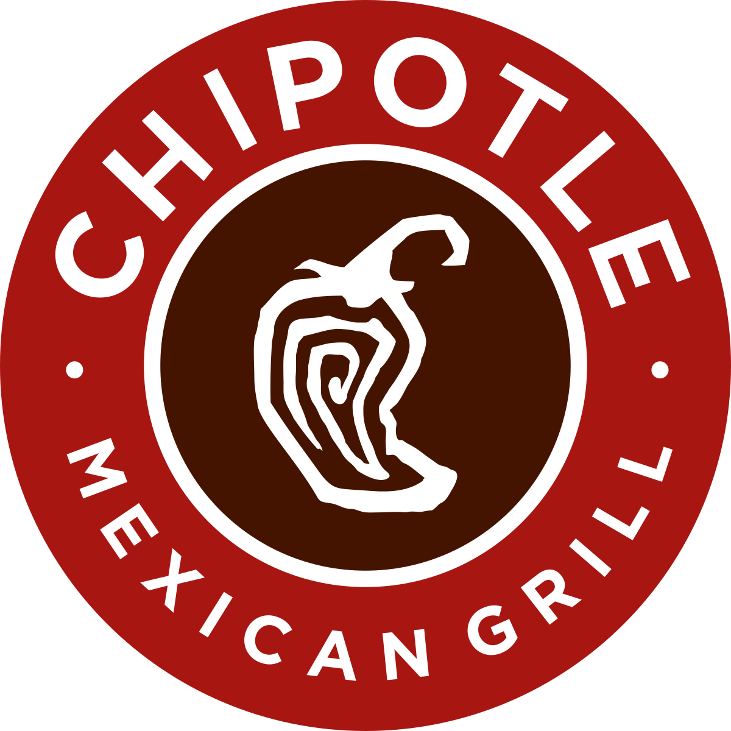
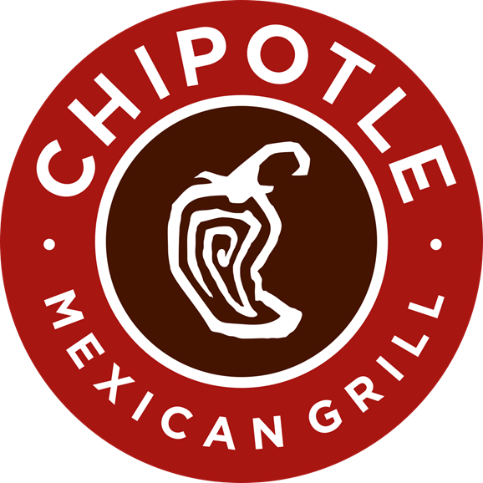
OPTIMIZATION OF MENU AVAILABILITY & PAIRING FOR CHIPOTLE
Python Methodologies
Lars Sorensen

Slide 2
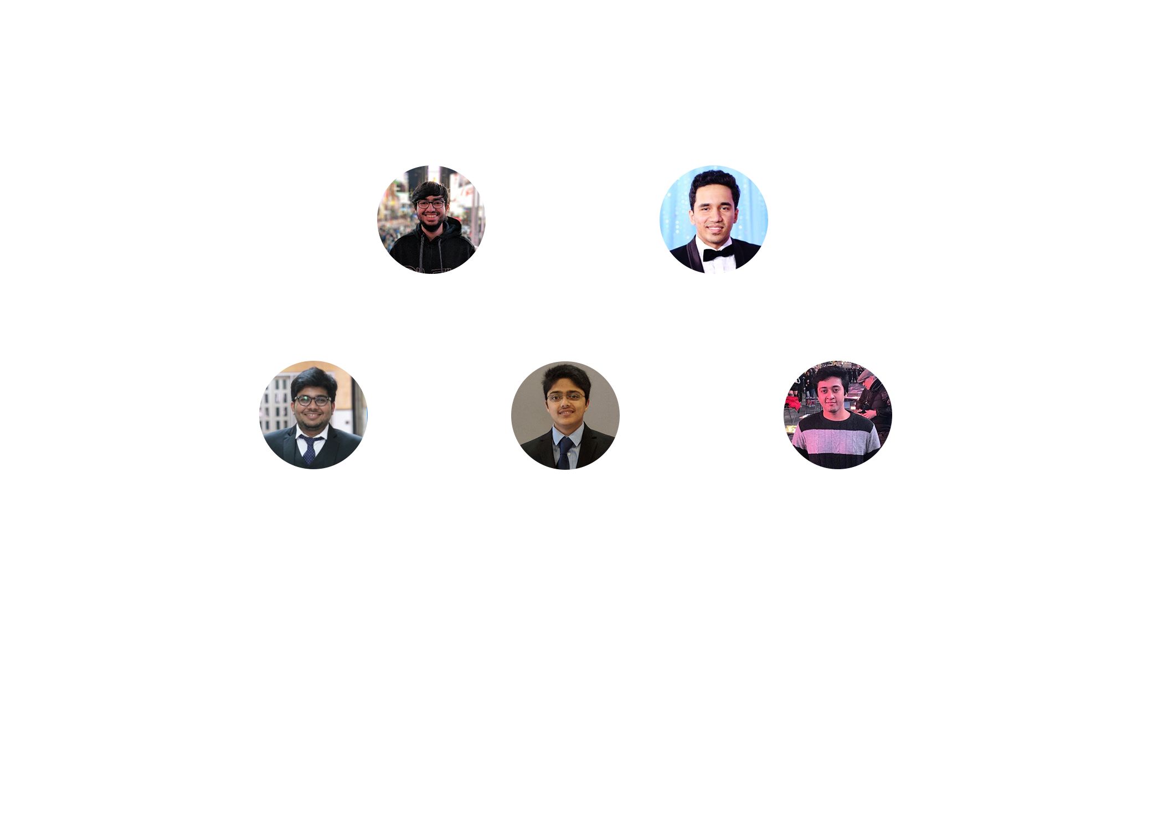
MEET THE TEAM!

Slide 3
INTRODUCTION
Founded on July 13, 1993
2250 locations & revenue worth $3904 millions
Specializes in affordable Mexican cuisine

Slide 4
PROJECT OBJECTIVES
Determine & categorize orders to learn consumer habits
Use association analysis to find hidden trends & develop new meal combos
Find most used ingredients to order extra stock

Slide 5
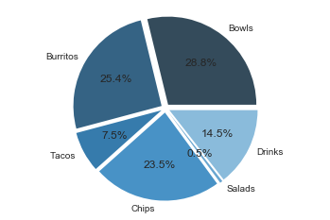
CATEGORIZING ORDERS
General Categorization
The menu items on chipotle menu can be broadly divided into six categories.
Bowls
Burritos
Chips
Tacos
Salads
Drinks
MENU OPTIMIZATION | CHIPOTLE

Slide 6
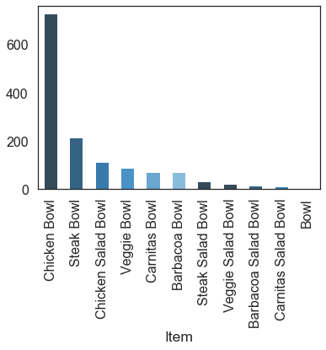
CATEGORIZING ORDERS
BOWLS
Now we will look further into Bowls. We will find the most popular bowls.
Chicken & Steak Bowls are by far the most popular ones.
MENU OPTIMIZATION | CHIPOTLE

Slide 7
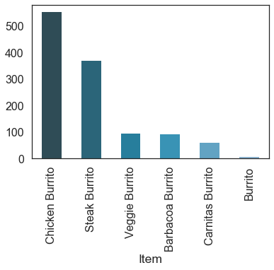
CATEGORIZING ORDERS
BURRITOS
Now we will look further into Burritos. We will find the most popular burritos.
Chicken & Steak Burritos are by far the most popular ones.
MENU OPTIMIZATION | CHIPOTLE

Slide 8
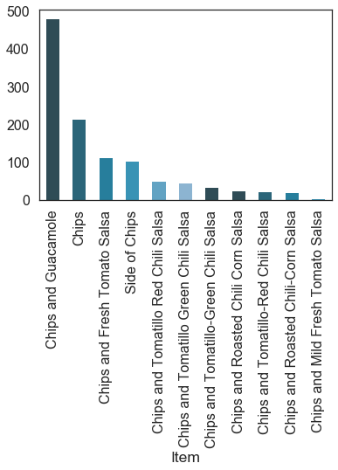
CATEGORIZING ORDERS
CHIPS
Now we will look further into Chips. We will find the most popular chips & sides.
Chips with Guacamole & Chips with Fresh Tomato Salsa are the popular choices.
MENU OPTIMIZATION | CHIPOTLE

Slide 9
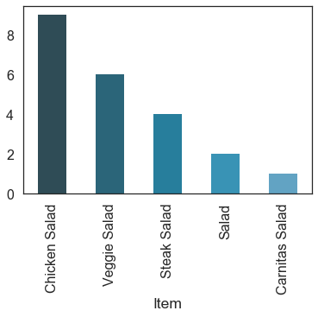
CATEGORIZING ORDERS
SALADS
Now we will look further into Salads. We will find the most popular Salads.
Chicken & Veggie Salads are the most popular choices.
MENU OPTIMIZATION | CHIPOTLE

Slide 10
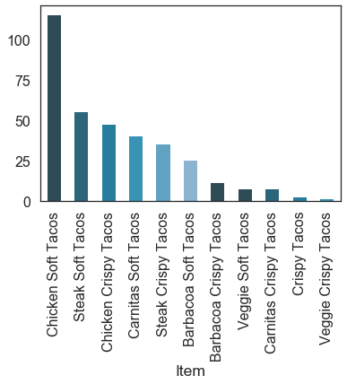
CATEGORIZING ORDERS
TACOS
Now we will look further into tacos. We will find the most popular tacos.
More people prefer Soft Tacos over Hard Tacos.
In this category Carnitas & Steak are very close second , while chicken is still the first.
MENU OPTIMIZATION | CHIPOTLE

Slide 11
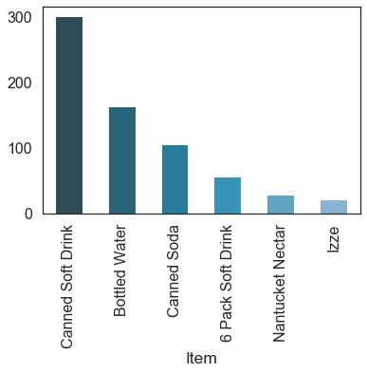
CATEGORIZING ORDERS
DRINKS
Now we will look further into Drinks. We will find the most popular Drinks.
Canned Soft Drinks & Bottled Water are the 2 most popular drinks.
MENU OPTIMIZATION | CHIPOTLE

Slide 12
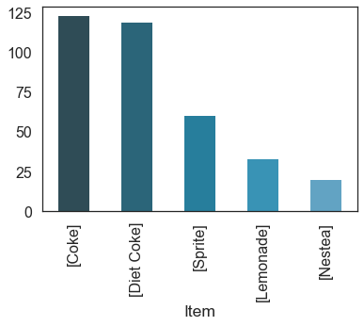
CATEGORIZING ORDERS
CANNED SOFT DRINKS
Canned Soft Drinks and Canned Sodas can be further categorized by brands.
Coke occupies the first 2 positions with their regular & diet versions.
MENU OPTIMIZATION | CHIPOTLE

Slide 13
MARKET BASKET ANALYSIS
Used to find hidden patterns from sets of data
Applying association rules to find new combos
Applying association rules to find ingredient dependencies

Slide 14
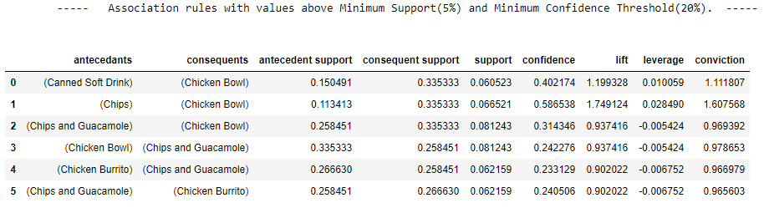
MARKET BASKET ANALYSIS
Associations found in orders
These associations can be used to make new meal combos

Slide 15
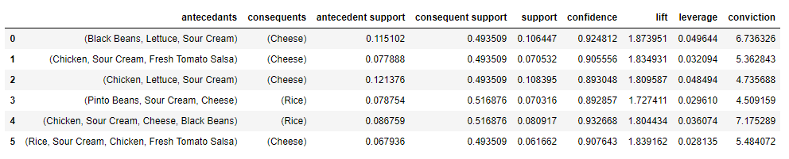
MARKET BASKET ANALYSIS
Associations found in Ingredients
These ingredients are highly dependent on each other
If one of the ingredient is unavailable the it will directly affect sales.

Slide 16
POPULAR INGREDIENT IDENTIFICATION
Most used ingredients are at risk of going out of stock
This can directly affect sales
Thus , it is necessary to keep a safety stock for these popular ingredients

Slide 17
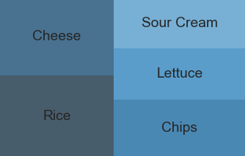
POPULAR INGREDIENT IDENTIFICATION

Slide 18
FUTURE SCOPE
This project was performed on the data provided on a single Chipotle outlet. This project could be scaled to include more branches for a larger region. Doing this will help us evaluate a strategy for a certain region pertaining to the demographics there.
This project could be integrated with other Chipotle systems to mine and provide continuous insights to the branch manager and thus help them solve a problem in its initial stages.

Slide 19


